Slide 1
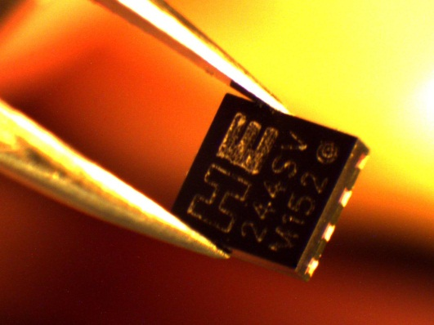
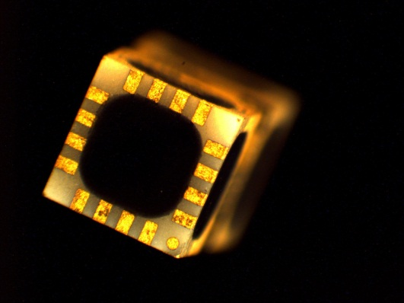
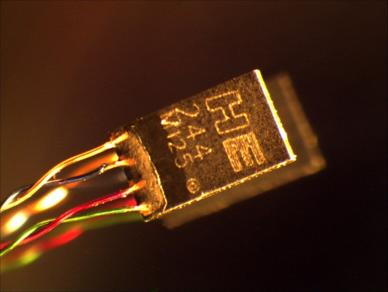
Asensor Technology AB
When Performance Matters
asensor.eu

Slide 2
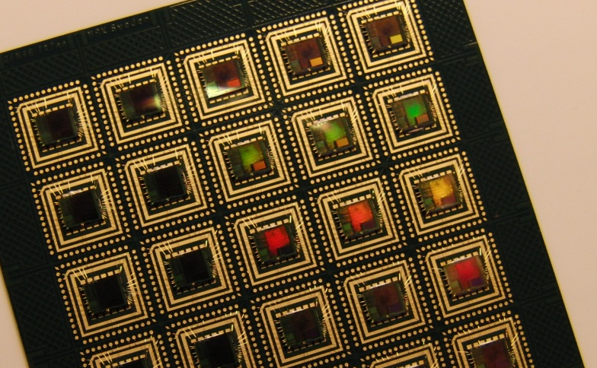

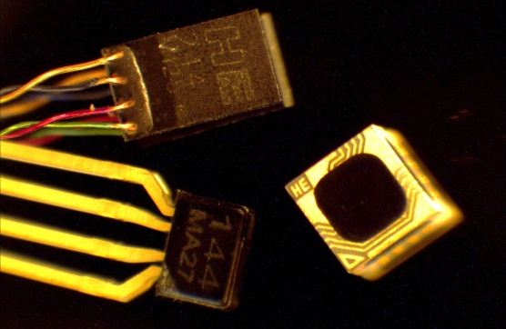
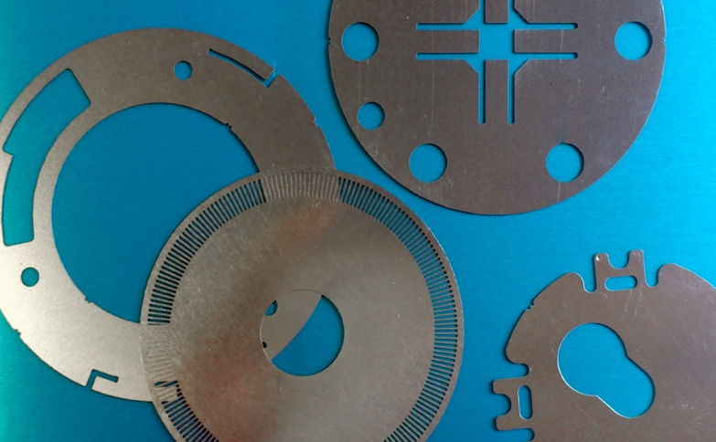
M A Kapslingsteknik AB
Founded in 1996
Business field: Interconnect and package electronics
Business concept:
Prototyping as well as small to medium scale manufacturing within the areas microelectronic assembly and encapsulation and potting
Asensor Technology AB
Founded in Oct 2012
Joint ownership between Sweden and Holland
Business concept:
Develop and sell advanced sensor products based upon semiconductor technology
NJ Innovation
Acquired in jan 2013
Business field: Gold/nickel plating and etching
Business concept:
To develop the different business fields, in particular gold plating with the intent to make our own bondable boards

Slide 3
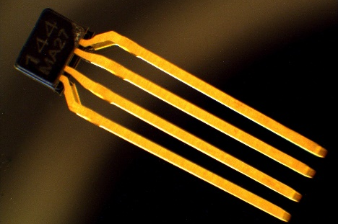
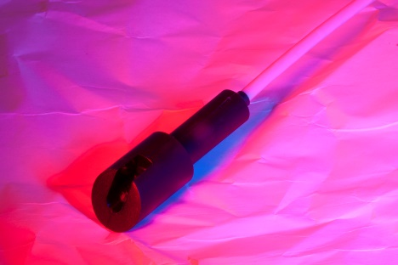
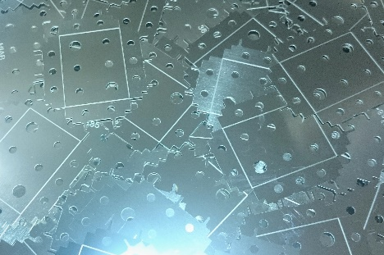
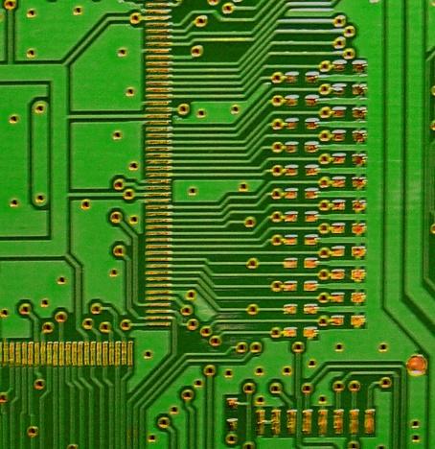
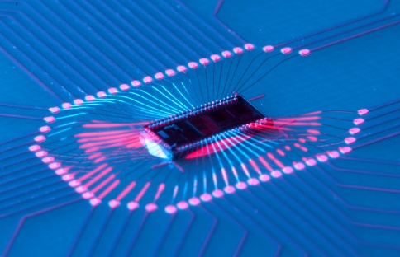
INHOUSE PRODUCTION
Our own
sensor products
Encapsulation and potting
Photo chemical etching
Microelectronic Assembly
Chemical and
electrolytic plating

Slide 4
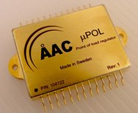
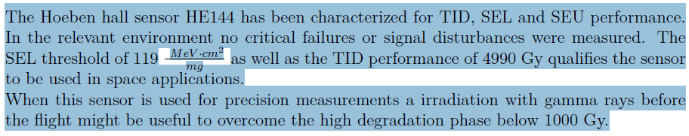
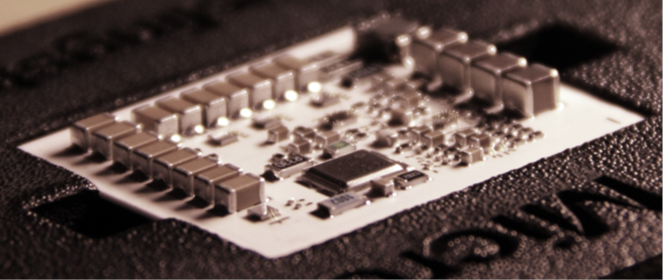
Microelectronics assembly & radiation
Our Hallsensor IC’s
Robustness by design
Robustness via material selection
Radiation hardness has been tested by DLR
and SRON, also for low temperature (cryogenic)
Upon request we can send DLR & SRON reports
DLR conclusion:
Hoeben Hallsensor HE144 is now the AST144, they
are the same and have always been produced in
Sweden, by MAK
Silicon & space …
Nah.. Not really
Silicon on Isolater (SOI) is
recommended or other concepts
Design for space is strongly recommended
We build mainly RF-modules and sensors to be used in space on customers specs.

Slide 5
Two different types of IC: 144 resp. 244
144
Offset -/+ 12.5mV
Offset drift < 40ppm/°C
R1 offset: -3.3 -/+ 0.6*mV
Sensitivity 180-360 mV/T
R1: 210- mV/T @ 1mA
Linearity -/+ 1,5T: <0,1%
From mT to double digit T
244
Offset -/+ 500 µV
Offset drift < 5 ppm/°C
Sensitivity (2 mA) 170-360 mV/T
Typical 210 mV/T @ 2 mA
Linearity -/+ 1,5T: <0,1%
From µT to double digit T
With lock-in amplifier from 10 nT range
Our process target is 220mV/T

Slide 6
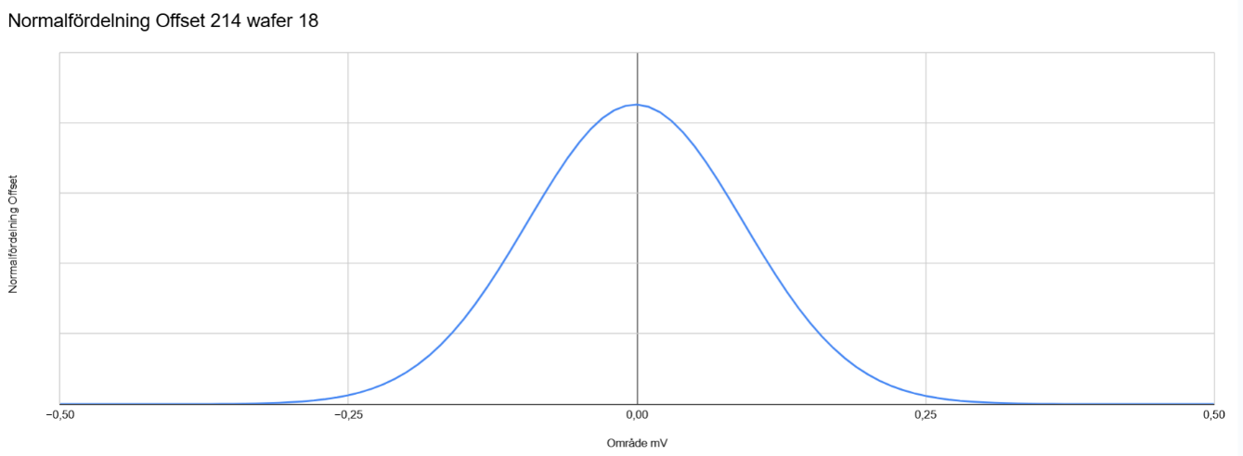
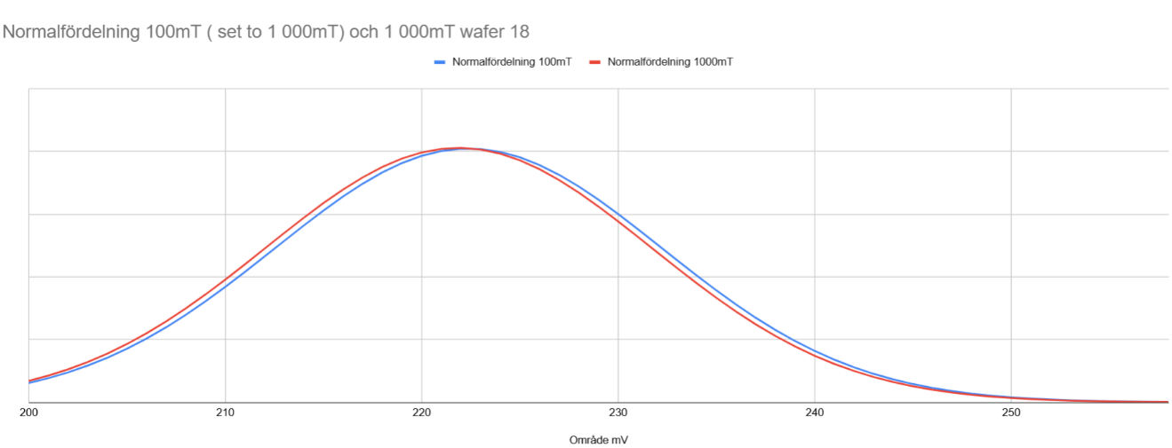
IC - two different types of IC 144 resp 244
244 wafer data
Offset 244 in zero gauss chamber Sensitivity of wafer 18
-0,25 mV 0,25 mV 200 mV 210 mV 250 mV
0,22% difference between 100
& 1 000mT, due to poor
calibration of the setup

Slide 7
















References
Hallsensors
§
Budker Institute
of Nuclear Physics

